Slide 1


LSTM STOCK PRICE prediction
Timothy Robbins
Bellevue University
Professor Catie Williams
October 10, 2020

Slide 2
Introduction

Slide 3
BACKGROUND

Slide 4


Slide 2
RECURRENT NEURAL NETWORKS
TRADITIONAL RNN’S
Weaknesses:
Short-term memory problem
Vanishing gradient problem
LSTM’s
Benefits:
Solution to above problems

Slide 5

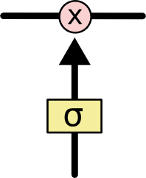
Slide 4
LSTM OVERVIEW
CELL STATE
GATES
Regulate flow of information
Learn what to keep or throw away
3 Gates
Forget Gate
Input Gate
Output Gate
Carries Information through network
Basically, the memory of the network

Slide 6
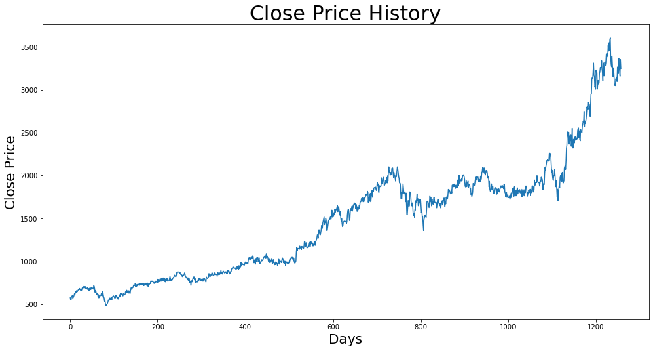
Initial DATASET
5 YEARS OF HISTORICAL DATA FOR AMZN
HISTORICAL
CLOSE
PRICE

Slide 7
DATA PREPROCESSING
Data frame created to store “close” price
Converted data frame to array
Normalized data
Created special data structure to store 60-time stamps
x_train
y_train
Reshaped data into 3-D array

Slide 8

BUILD and compile MODEL
Parameters:
Model type = Sequential
Input layer plus 3 additional layers
Timestamps = 60
Units = 100
Dropout = 20%
Optimizer = Adam
Loss function = Mean Squared Error (MSE)
Batch Size = 20
Epochs = 100

Slide 9
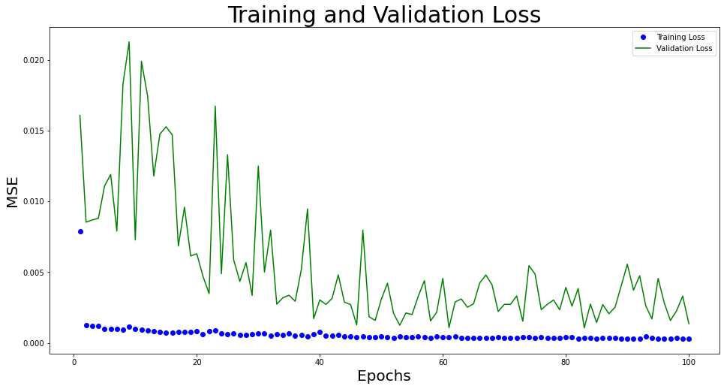
fit MODEL - Loss

Slide 10
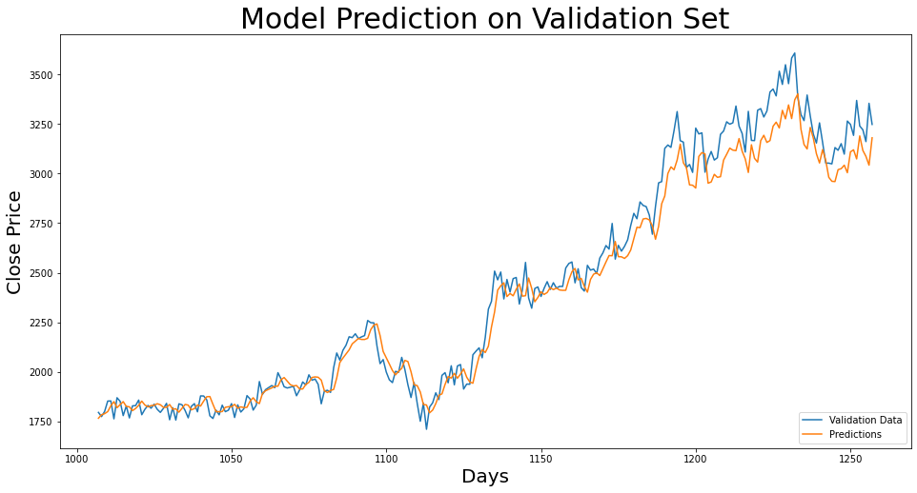
FIT MODEL - prediction

Slide 11
RESULTS/conclusion

Slide 12
APPENDIX
Table 1 – LSTM Model Parameters
Model: "sequential" _________________________________________________________________ Layer (type) Output Shape Param # ================================================================= lstm (LSTM) (None, 60, 100) 40800 _________________________________________________________________ lstm_1 (LSTM) (None, 60, 100) 80400 _________________________________________________________________ dropout (Dropout) (None, 60, 100) 0 _________________________________________________________________ lstm_2 (LSTM) (None, 60, 100) 80400 _________________________________________________________________ dropout_1 (Dropout) (None, 60, 100) 0 _________________________________________________________________ lstm_3 (LSTM) (None, 100) 80400 _________________________________________________________________ dropout_2 (Dropout) (None, 100) 0 _________________________________________________________________ dense (Dense) (None, 1) 101 ================================================================= Total params: 282,101 Trainable params: 282,101 Non-trainable params: 0 _________________________________________________________________

Slide 13
REFERENCES
Anderson, R. (2019, December 23). Stock Price Prediction Using Python & Machine Learning. Retrieved from Medium: https://medium.com/@randerson112358/stock-price-prediction-using-python-machine-learning
Banushev, B. (2019, January 14). Using the latest advancements in AI to predict stock market movements. Retrieved from Python Awesome: https://pythonawesome.com/using-the-latest-advancements-in-ai-to-predict-stock-market-movements/
Ganegedara, T. (2020, January 1). Stock Market Predictions with LSTM in Python. Retrieved from Data Camp: https://www.datacamp.com/community/tutorials/lstm-python-stock-market
Koehrsen, W. (2018, January 19). Stock Prediction in Python. Retrieved from Towards Data Science: https://towardsdatascience.com/stock-prediction-in-python
Kohorst, L. (2018, November 9). Predicting Stock Prices with Python. Retrieved from Towards Data Science: https://towardsdatascience.com/predicting-stock-prices-with-python
Migdon, H. (2020, September 2). How To Use the Alpha Vantage API with Python to Create a Stock Market Prediction App. Retrieved from Last Call - The RapidAPI Blog: https://rapidapi.com/blog/stock-market-prediction-python-api/
Müller, F. (2020, March 24). Stock market prediction: a time series forecasting problem. Retrieved from Relataly: https://www.relataly.com/stock-market-prediction-using-a-recurrent-neural-network
Nayak, A. (2019, March 18). Predicting Stock Price with LSTM. Retrieved from Towards Data Science: https://towardsdatascience.com/predicting-stock-price-with-lstm
Pochetti, F. (2014, September 20). Stock Market Prediction in Python Intro. Retrieved from Francesco Pochetti: http://francescopochetti.com/stock-market-prediction-part-introduction
Shamdasani, S. (2017, December 15). Build a Stock Prediction Algorithm. Retrieved from Enlight: https://enlight.nyc/projects/stock-market-prediction
Shyam R, V. P. (2020). Stock Prediction Overview and a Simple LSTM based Prediction Model. International Research Journal of Engineering and Technology (IRJET).

